Slide 1
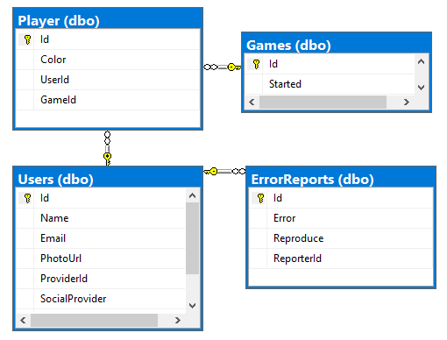
Frontend browser
Angular 11
Backend server
.net 5 Web Api
AccountController
ToplistController
InviteController
Rest
Web sockets
GameService
GameManager
Rules
Login
Entity framework core
Sql Server
Google Facebook

